Slide 1

Introduction to Artificial Intelligence Group 1 Week 6
Dr. Juan Carlos Rojas
Juan-Carlos.Rojas@ttu.edu

Slide 2
Schedule
Date | Class | HW Assigned | HW Due
May 18 | Class 1 | HW1
May 25 | Class 2 | HW2 | HW1
June 1 | Class 3 | HW3 | HW2
June 8 | Class 4 | HW4 | HW3
June 15 | No class
June 22 | Class 5 | HW5 | HW4
June 29 | Class 6 | HW6 | HW5
July 6 | Class 7 | HW7 | HW6
July 13 | Class 8 |  | HW7

Slide 3
Agenda for Week 6
Theory
Neural Networks
History
Topologies
Shallow networks
Effect of learning rate
Adaptive learning schemes
Early stopping
Effect of number of nodes
Regularization
Practice
Neural networks in TensorFlow
Shallow NN of MNIST
Shallow NN of Vehicle Price
Shallow NN of Credit Default
Early stopping
Adaptive learning
Regularization

Slide 4
Aviso 1
Para todos los becados por el MICITT, es obligatorio llenar un formulario inicial de participantes que pueden localizar en el siguiente enlace:
http://www.conicit.go.cr/tramites/Seguimiento_PINN.aspx.
Buscar “Formulario de información inicial para los participantes”, y seguir el vínculo al formulario electrónico.
Necesito que todos firmen la hoja denominada “Lista de confirmación de requerimiento de evaluación inicial”
Sólo tengo 41 firmas. Deben ser 47.

Slide 5
Aviso 2
Para todos los becados por el MICITT, una vez finalizado el curso, es obligatorio llenar el formulario de evaluación del curso e instructor que pueden localizar en el siguiente enlace:
http://www.conicit.go.cr/tramites/Seguimiento_PINN.aspx.
Buscar “Formulario de evaluación del curso o módulo y del Instructor”, y seguir el vínculo al formulario electrónico.
Necesito que todos firmen la hoja denominada “Lista de confirmación de requerimiento de evaluación final y del instructor”

Slide 6
Aviso 3
Para todos los becados por el MICITT, seis meses después de completar el curso, es obligatorio llenar el formulario de informe expost de calificación profesional que pueden localizar en el siguiente enlace:
http://www.conicit.go.cr/tramites/Seguimiento_PINN.aspx.
Buscar “Formulario del Informe Expost Calificación Profesional”, y seguir el vínculo al formulario electrónico.
Necesito que todos firmen la hoja denominada “Informe Expost Calificación Profesional, PINN”

Slide 7
Neural Networks

Slide 8
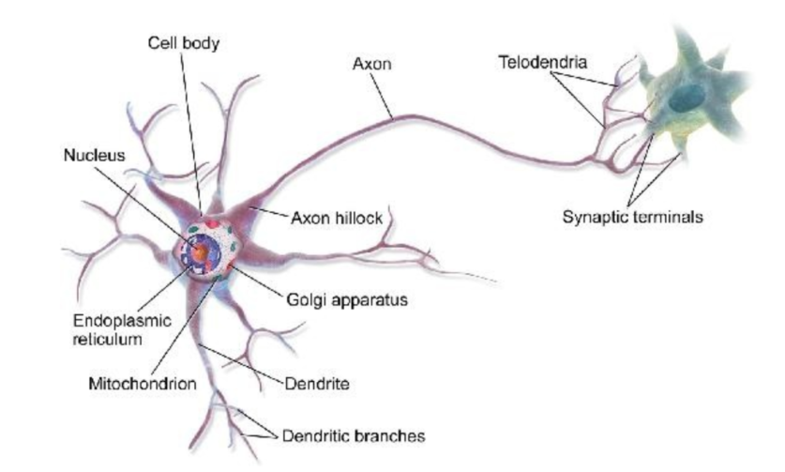
Inspiration of Neural Networks
Brain neurons are interconnected to others by axons
They activate by sending a spike of electrical charges (synapses)
Neurons fire/activate in response to the level of activation of their neighbors

Slide 9
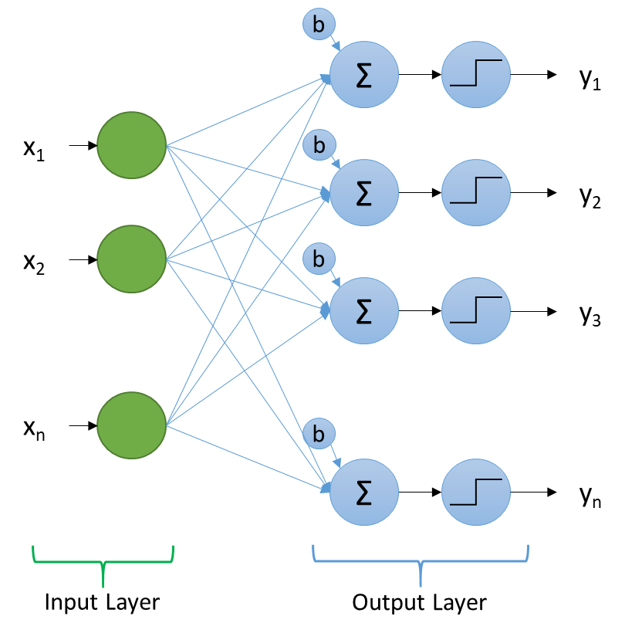
The Perceptron
An early prototype of artificial neural network
Also known as Linear Threshold Unit (LTU)
A linear combination of inputs, followed by a step function
The output of each LTU is 1 or 0
The step function is considered an activation function
Mimics brain neural activations
Equivalent to Linear Regression with a threshold

Slide 10
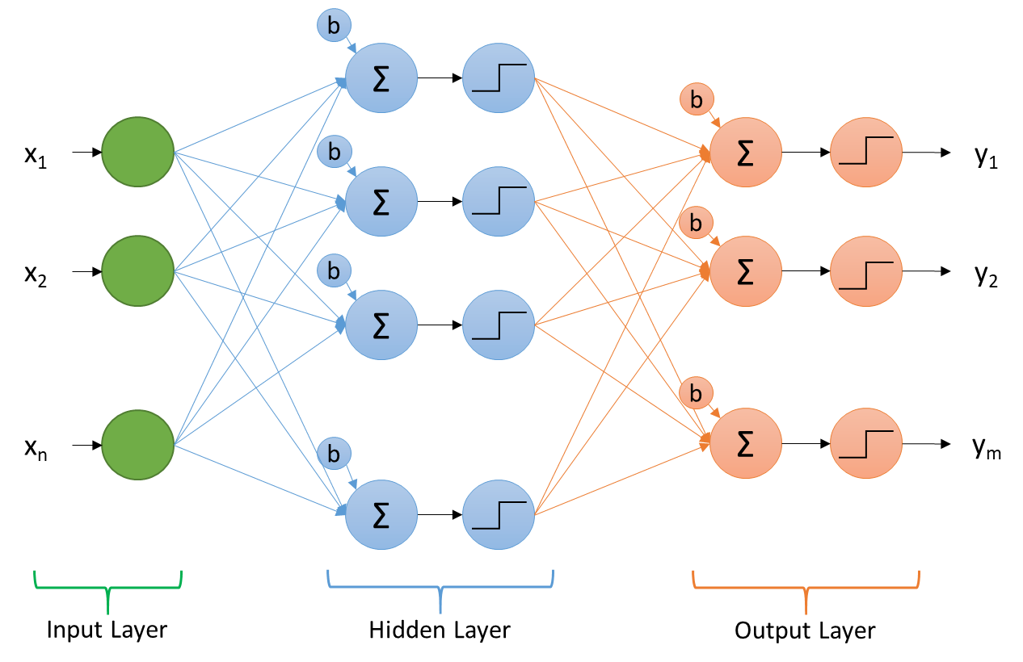
Multi-Layer Perceptron (MLP)
Adds one or more hidden layers
Each is a linear combination of the previous, followed by a step activation function
No successful way to train it
Cannot use gradient descent (gradients are zero)

Slide 11
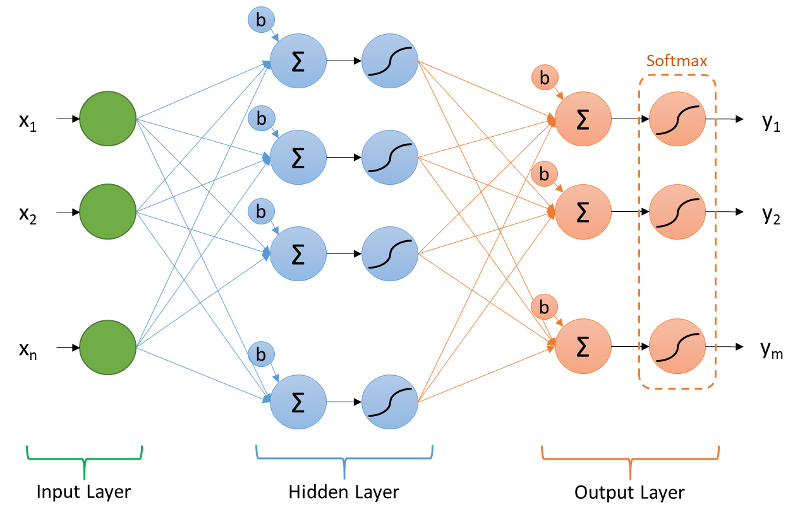
Multi-Layer Sigmoid Regression
Uses a sigmoid as the activation function of the hidden layer neurons
Uses softmax for the output layer
Can be trained by gradient descent
Computed efficiently using reverse-mode auto-diff
A.k.a. back-propagation
This is the basis of most modern neural networks

Slide 12
Anatomy of a Neural Network
b
Σ
Softmax
b
x₁
b
Σ
y₁
Σ
b
x₂
b
Σ
y₂
Σ
b
x_{n}
Σ
y_{m}
b
Σ
Input Layer
Hidden Layer
Output Layer

Slide 13
The Need for Activation Functions
Activation functions in hidden layers introduce non-linearities
Without them, the entire structure would be a linear system
Limited flexibility to fit to data
Allows the network to become a universal function approximator
Any non-linear function will work
But we want it to be differentiable so we can use it in gradient descent
Several activation functions are used in practice

Slide 14
Activation Functions for Output Layer
Type of Problem | Recommended Activation Function | Characteristics
Regression | Linear | Keep the linear combination of values
Binary classification | Logistic | A sigmoid function with outputs between 0 and 1
Multinomial classification | Softmax | Each output is between 0 and 1 All values add-up to 1.0

Slide 15
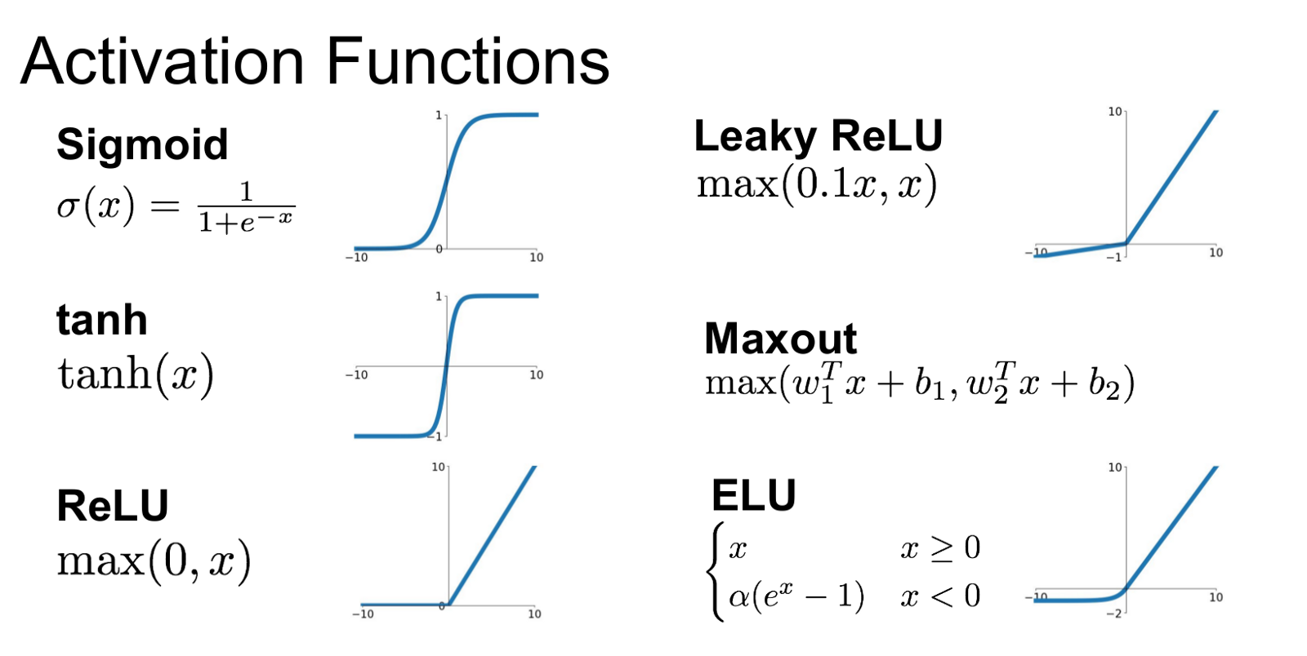
Activation Functions for Hidden Layers
Activation Function | Characteristics
Hyperbolic Tangent (TanH) | A sigmoid function with outputs between -1 and 1 Expensive to compute Subject to vanishing gradients
Rectified Linear Unit (ReLU) | Fast and effective Avoids vanishing gradients Can lead to neuron death
Leaky ReLU | A modified version that prevents neuron death
Exponential Linear Unit (ELU) | Best performing Avoids discontinuity around zero Expensive to compute

Slide 16
Shallow Neural Networks
Networks with 1 hidden layer
Generally referred to as a 2-layer network
One hidden layer
One output layer
The input layer is not counted
The number of nodes in the output layer is determined by the number of outputs
The number of nodes in the hidden layer can be chosen at will
More nodes will allow the model to capture more complexity

Slide 17
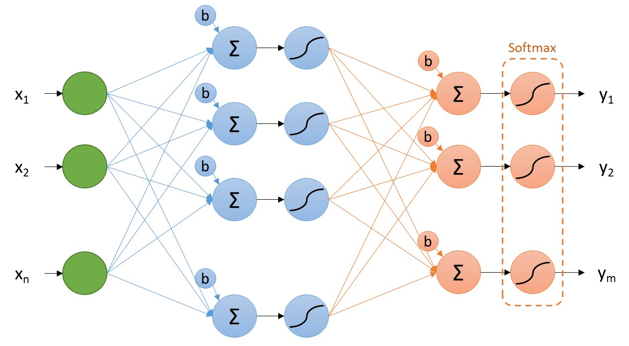
2-Layer Neural Net on TensorFlow
Let’s create a 2-layer network for solving the MNIST classification problem
We will use TanH activation on the hidden layer
And softmax for the output layer
The number of nodes in the hidden layer will be a tunable design parameter
Along with the learning rate, mini-batch size, and number of epochs
See Mnist_NN_1.py

Slide 18
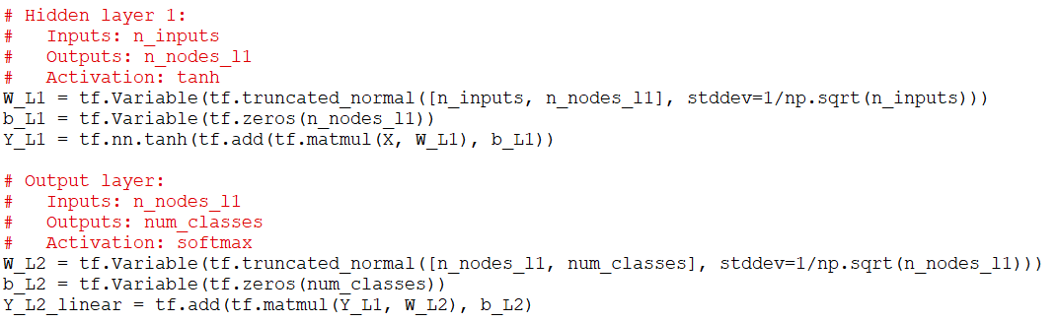
2-Layer Neural Net on TensorFlow
We’ll start with the previous implementation of softmax regression with mini-batch gradient descent
We modify the computations to include the two layers
The output of the first layer becomes the input of the second layer
See Mnist_NN_1.py

Slide 19


2-Layer Neural Net on TensorFlow
The cost function is the same as before (softmax cross entropy)
But applied to the output of the second layer
The prediction values are also computed from the output of the second layer
Still need to add the softmax to the linear outputs, and then find the maximum
See Mnist_NN_1.py

Slide 20
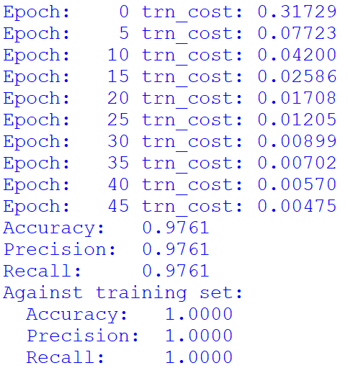
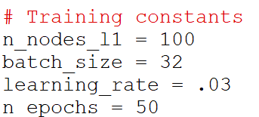
2-Layer Neural Net on TensorFlow
Try with 100 nodes in layer 1:
Very promising results!
But…
Is the learning rate OK?
Is the number of epochs OK?
Is the number of hidden nodes OK?
See Mnist_NN_1.py

Slide 21
Gaining Better Insight about Model Fit
The measurement of the average training cost is useful
But it doesn´t tell us how well the model will perform against the test data
We can capture additional metrics that will give us better insight:
The prediction accuracy against the training data
The cost function against the test data
The prediction accuracy against the test data

Slide 22
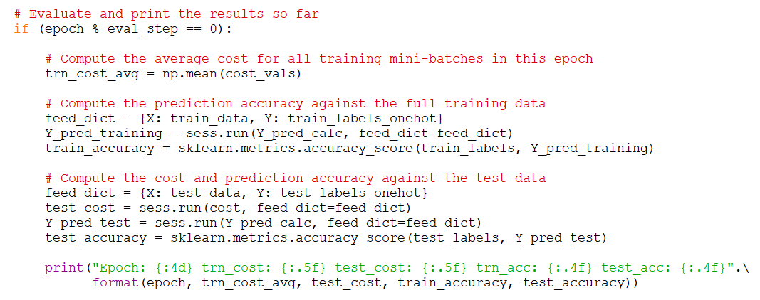
Gaining Better Insight about Model Fit
See Mnist_NN_2.py

Slide 23
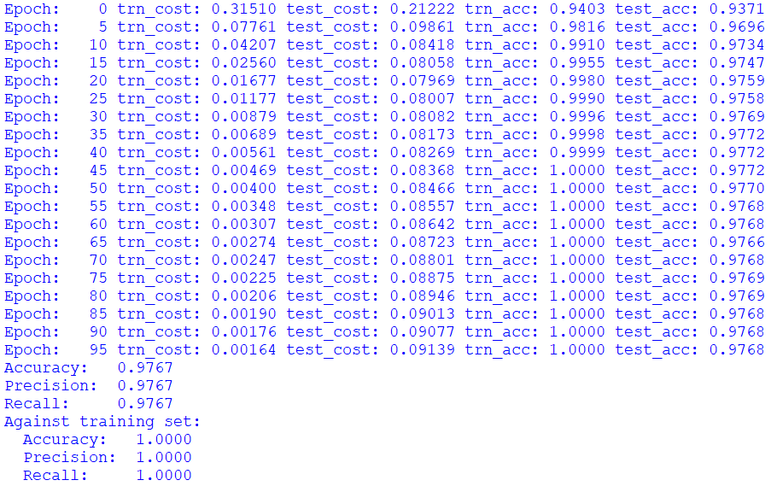
Gaining Better Insight about Model Fit
With:
100 hidden nodes
TanH activation
batch_size = 32
learning_rate = 0.03
n_epochs = 100
It would be nice to plot the results
See Mnist_NN_2.py

Slide 24
Practice 1
Consider the 2-layer neural network for MNIST classification
From Mnist_NN_2.py
Save a history of the four measurements at every epoch eval step:
Cost against training data
Cost against test data
Accuracy against training data
Accuracy against test data
Hints:
Define a Python list for each, and append the values every time you compute them
Make two plots using MatPlotLib
Cost vs. epoch (both training and test)
Accuracy vs. epoch (both training and test)

Slide 25
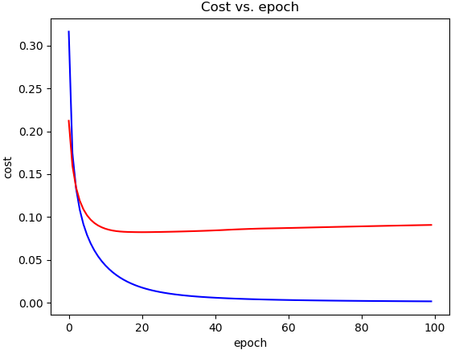
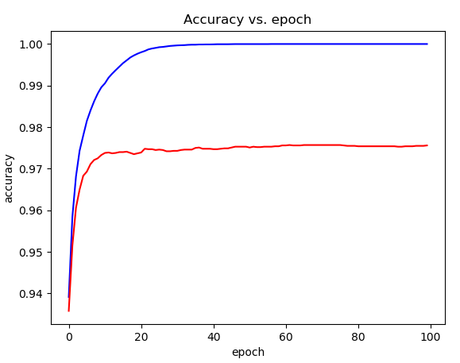
100 neurons, learning_rate=0.03, 100 epochs

Slide 26
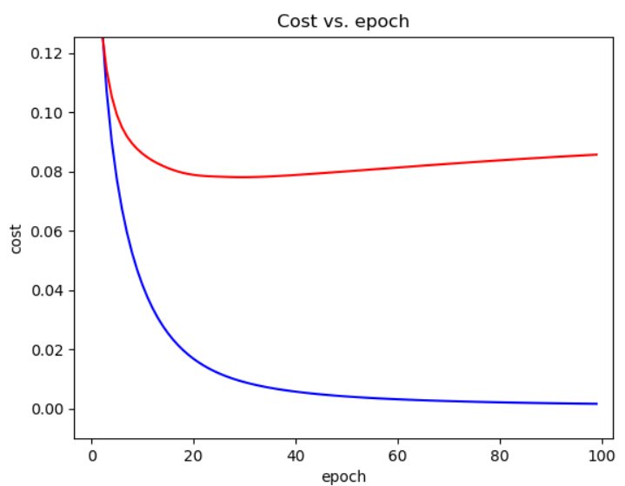
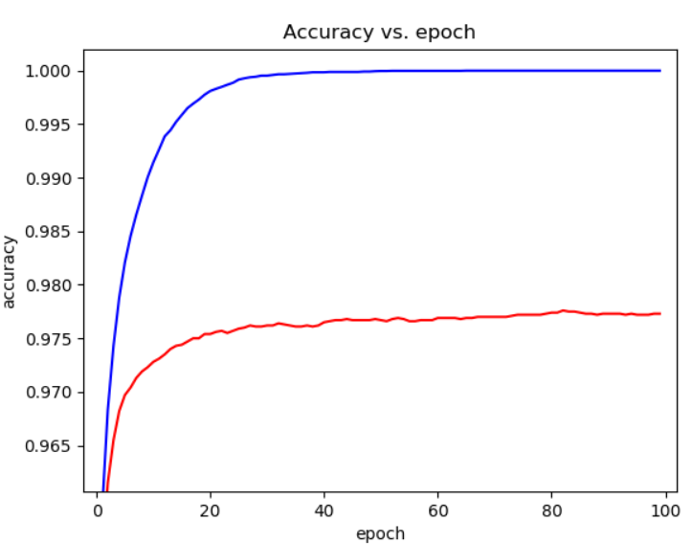
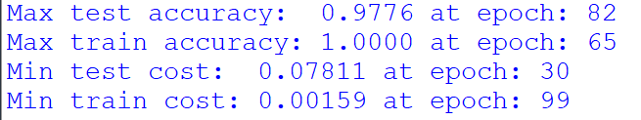
100 neurons, learning_rate=0.03, 100 epochs
Lowest test cost
Observations:
Test cost reaches a minimum at epoch 30, then slightly degrades
Test accuracy continues to improve for a few more epochs
Then just oscillates around the maximum values
Cost values roughly predict accuracy, but not exactly

Slide 27
What if we let it run Longer?
Will the behavior continue?
See Mnist_NN_3.py

Slide 28
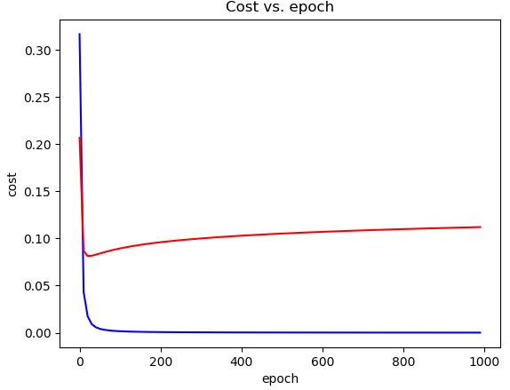
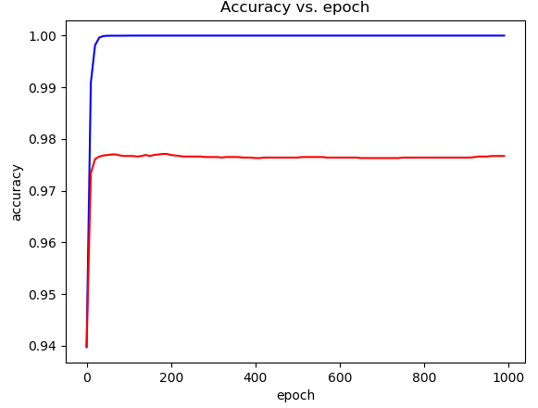
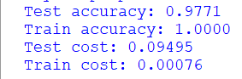
100 neurons, learning_rate=0.03, 1000 epochs
Observations:
The test cost continues to degrade
The test accuracy remains stable
It is more common to have it degrade too

Slide 29
About the Learning Rate
Is 0.3 a reasonable learning_rate?
Let’s run multiple rates and compare the behavior
See Mnist_NN_3.py

Slide 30
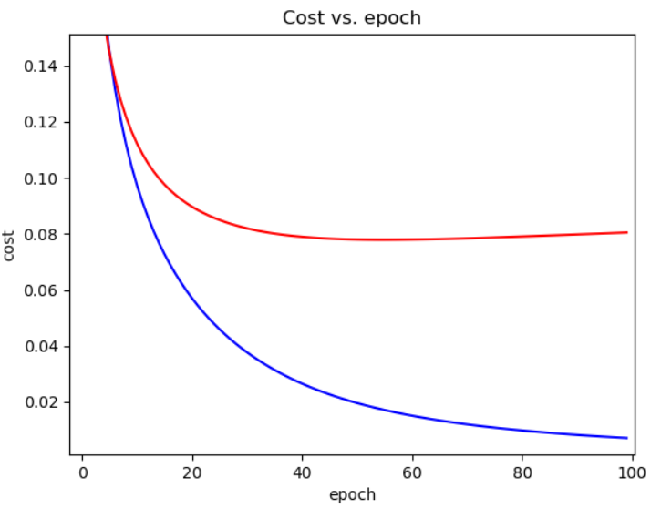
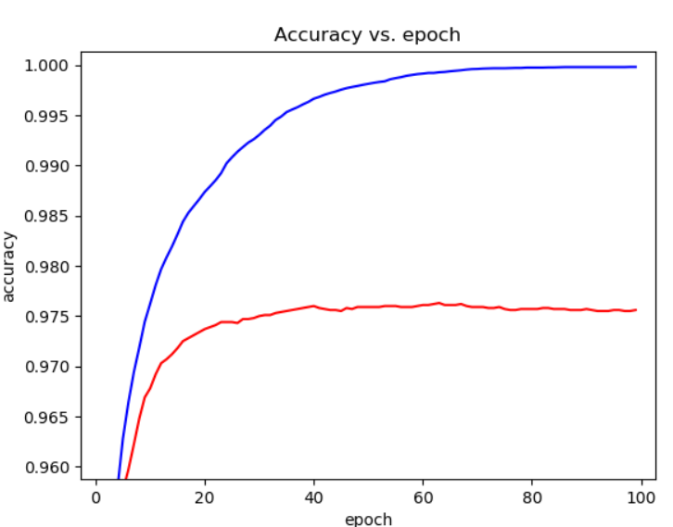
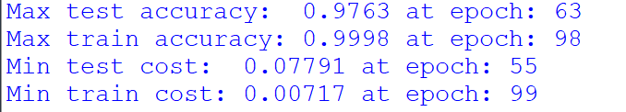
100 neurons, learning_rate=0.01, 100 epochs

Slide 31
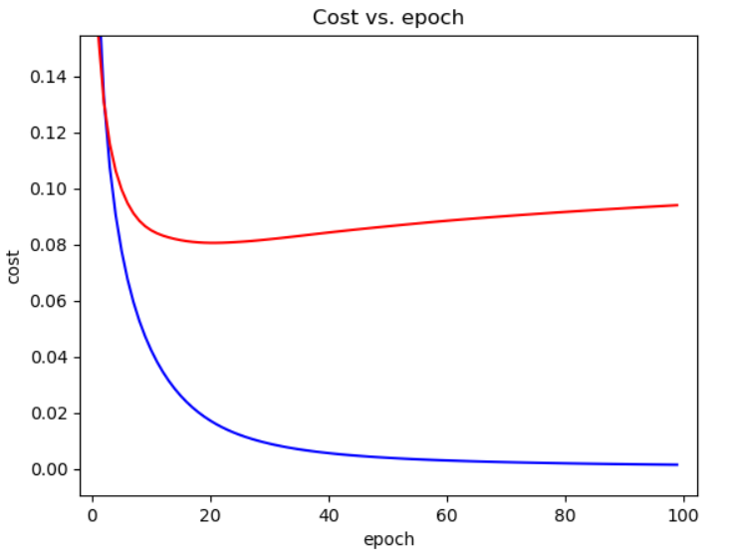
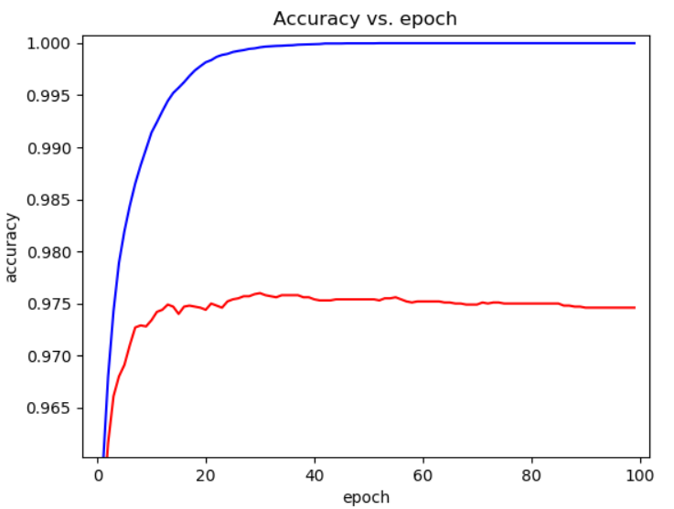
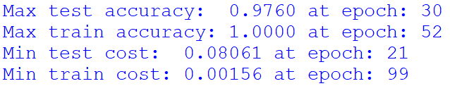
100 neurons, learning_rate=0.03, 100 epochs

Slide 32
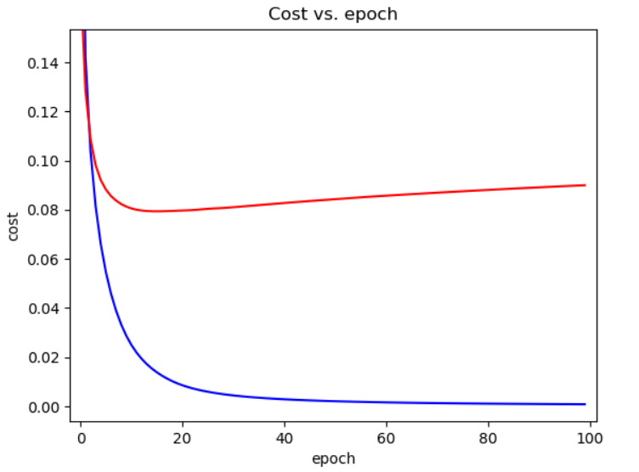
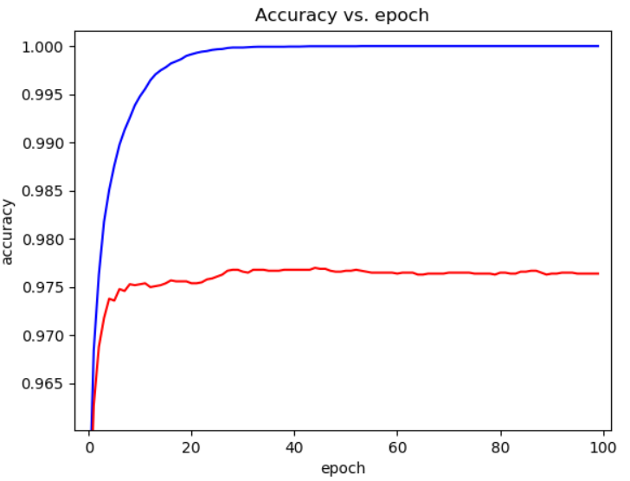
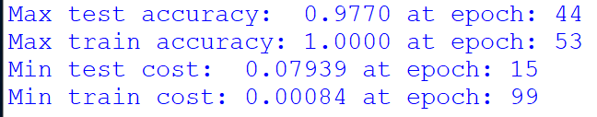
100 neurons, learning_rate=0.05, 100 epochs

Slide 33
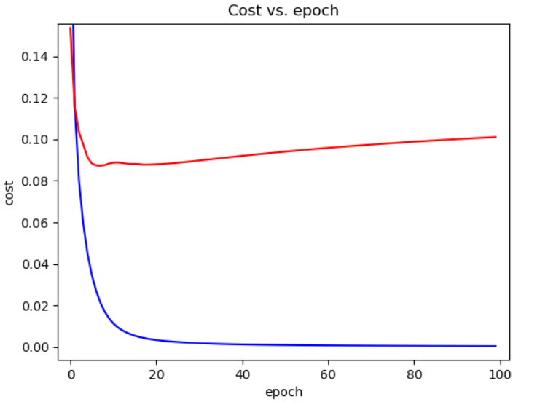
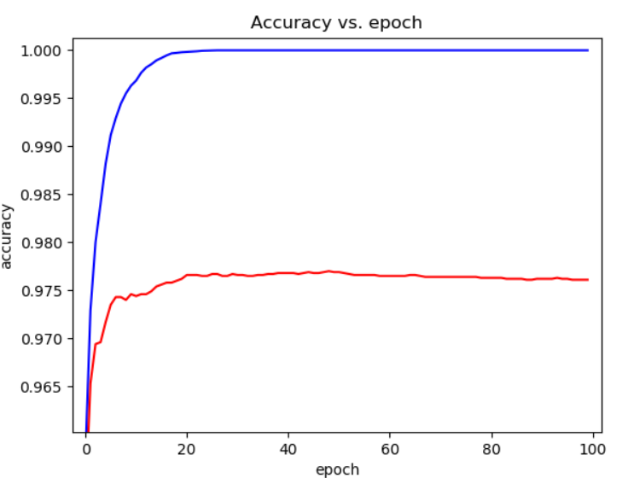
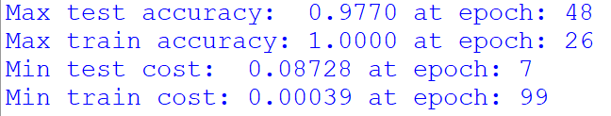
100 neurons, learning_rate=0.1, 100 epochs

Slide 34
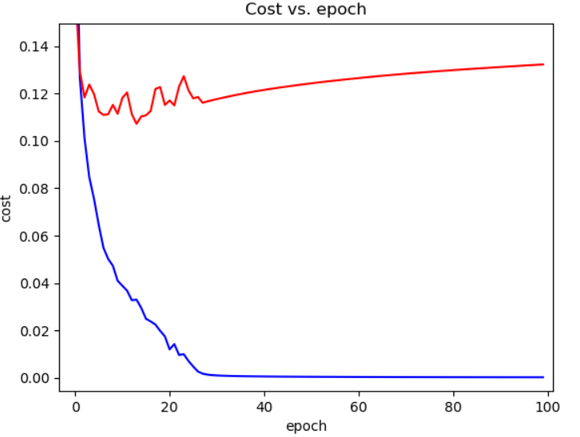
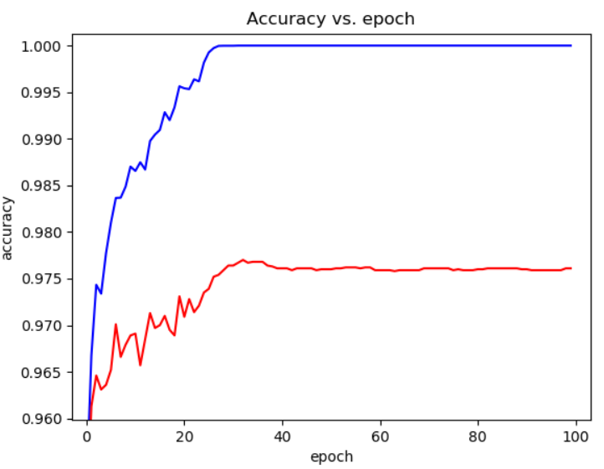
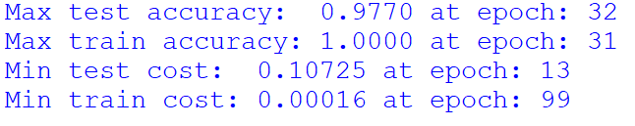
100 neurons, learning_rate=0.3, 100 epochs
Jumpy approach to gradient descent
Converging slower
No clear minimum in test cost

Slide 35
About the Learning Rate
If it is too high, we will have a “jumpy” descent
Risks not finding the minimum
A well tuned rate will produce a fast & smooth descent
Like 0.1 in this example
Making it smaller makes the convergence slower
But results are not necessarily better
The behavior can be different for every problem and network
Some do converge deeper with lower learning rates
It is important to explore and understand the behavior of your system through experiments

Slide 36
About the Number of Hidden Neurons
Let’s observe the behavior with different numbers of hidden nodes

Slide 37
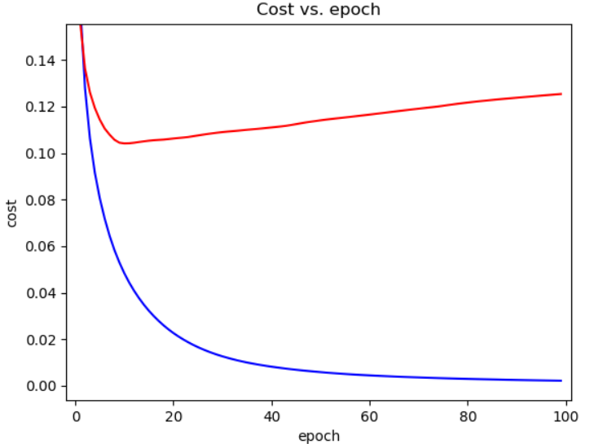
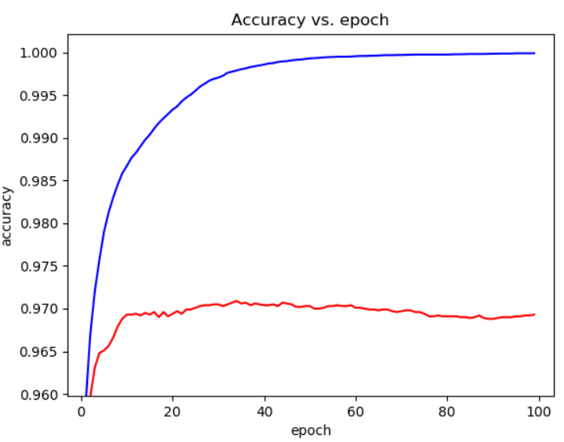
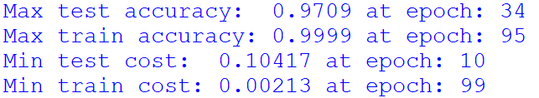
50 neurons, learning_rate=0.05, 100 epochs

Slide 38
100 neurons, learning_rate=0.1, 100 epochs

Slide 39
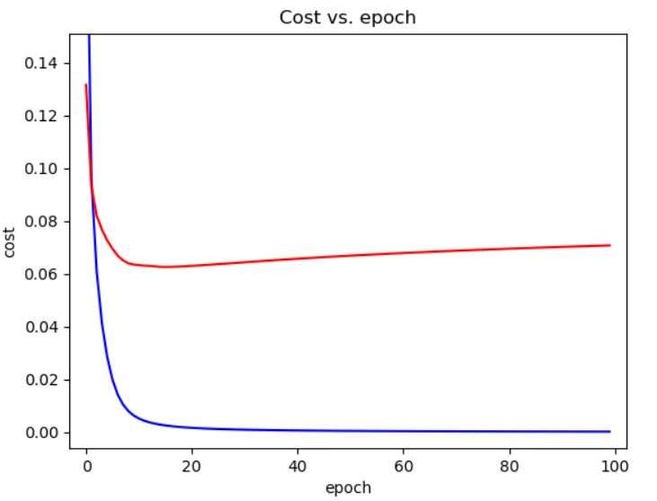
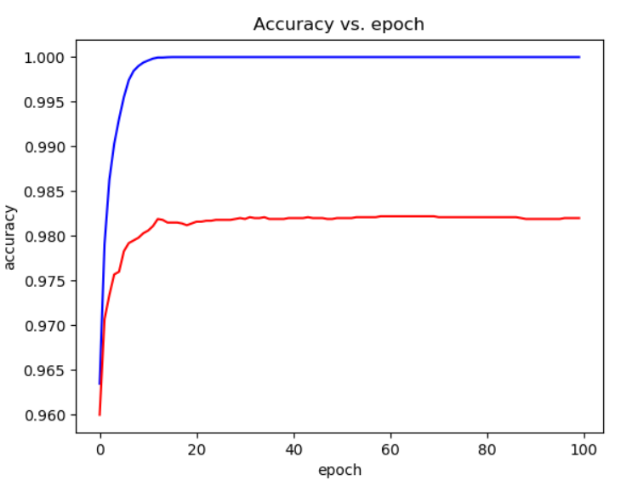
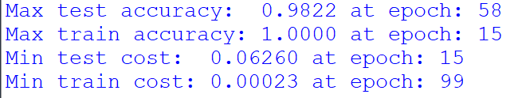
200 neurons, learning_rate=0.1, 100 epochs

Slide 40
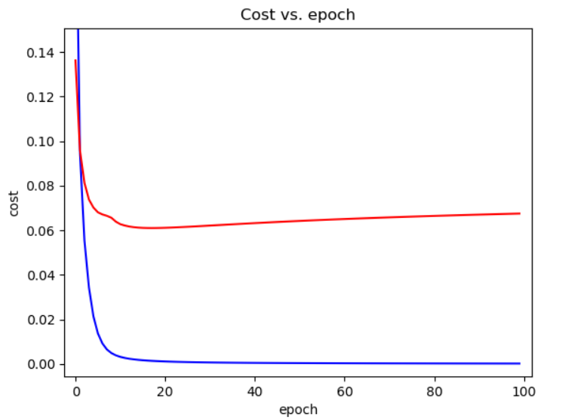
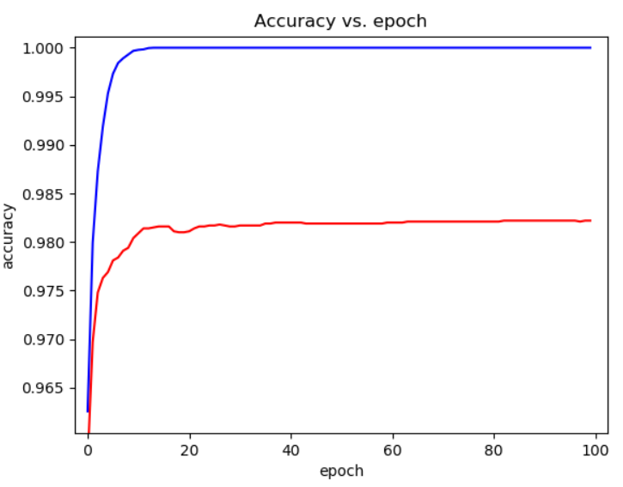
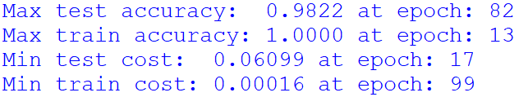
500 neurons, learning_rate=0.1, 100 epochs

Slide 41
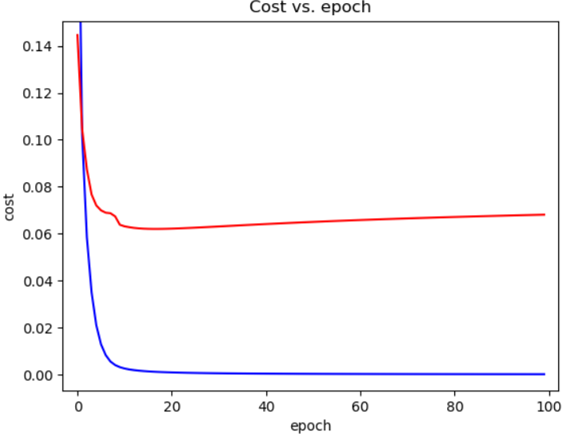
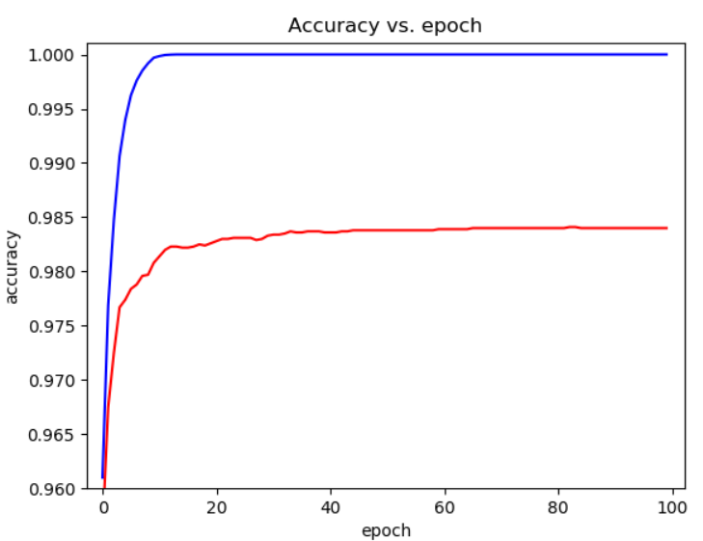
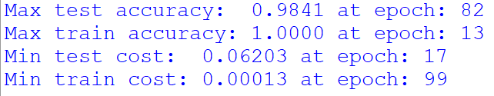
1000 neurons, learning_rate=0.1, 100 epochs

Slide 42
Effect of the Number of Hidden Neurons on MNIST
Number of Hidden Nodes | Learning Rate | Max Test Accuracy | Max Train Accuracy | Min Test Cost | Min Train Cost
10 | 0.01 | 0.928 | 0.95 | 0.251 | 0.16379
20 | 0.05 | 0.943 | 0.97 | 0.205 | 0.05172
50 | 0.05 | 0.971 | 0.99 | 0.104 | 0.00213
100 | 0.1 | 0.977 | 1.00 | 0.087 | 0.00039
200 | 0.1 | 0.982 | 1.00 | 0.062 | 0.00023
500 | 0.1 | 0.982 | 1.00 | 0.060 | 0.00016
1000 | 0.1 | 0.984 | 1.00 | 0.062 | 0.00013
Fewer nodes requires slower learning rate

Slide 43
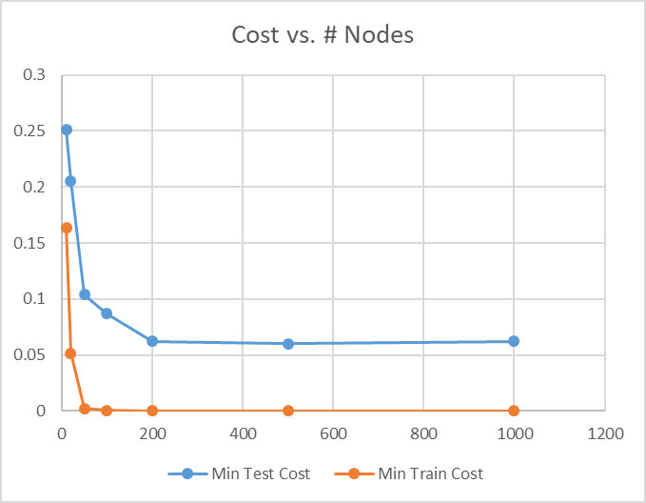
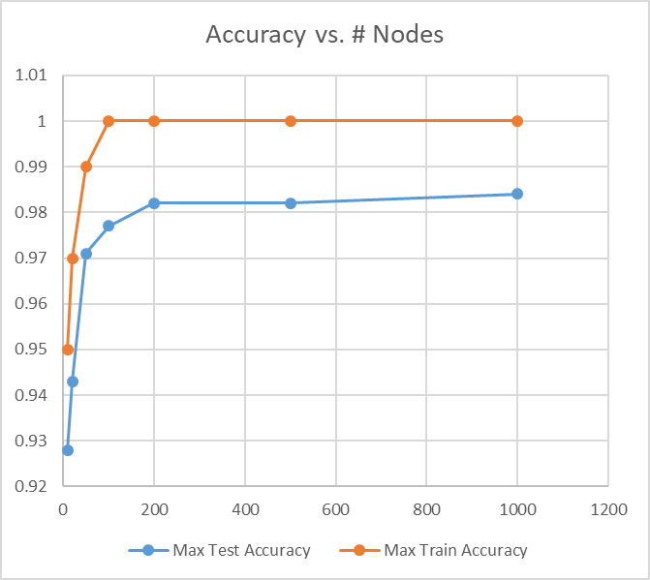
Effect of the Number of Hidden Neurons on MNIST
More nodes produces better results
Diminishing returns after ~200 nodes
Cost roughly represents accuracy, but not exactly

Slide 44
Optional HW Problem 1b
Train a 2-layer neural network for MNIST with:
200 neurons
Learning rate = 0.05
100 epochs
TanH activation function in the hidden layer
Graph the performance over time
Report the best test accuracy
Based on Mnist_NN_3.py
Change the activation function to ReLU
How do your results compare with the previous?
Did it train any faster?
Now change to ELU
Did your results improve?

Slide 45
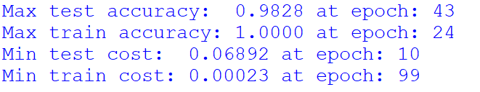
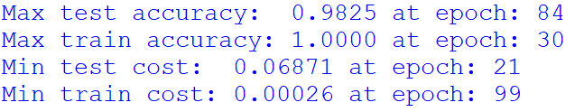
Optional HW Problem 1b
With Softmax:
With ReLU:
With ELU:
There may be run-to-run variations
Run a few times to be sure of trends

Slide 46

2-Layer NN for Vehicle Price Regression
It is very similar to the MNIST
There is only one output, so this is reflected in the definition of Y
See VehiclePrice_NN_1.py

Slide 47

2-Layer NN for Vehicle Price Regression
Chose to use ELU activation for the hidden layer
Others can work too
We use no activation in the output layer
Y_L2_linear will go directly into the cost function optimizer
See VehiclePrice_NN_1.py

Slide 48

2-Layer NN for Vehicle Price Regression
The cost function is the mean square error of the layer 2 outputs
The test metrics are RMSE (the square root of the costs)
See VehiclePrice_NN_1.py

Slide 49



100 neurons, learning_rate=1e-5, 100 epochs
Noisy
We should reduce the learning rate
Not fully converged
Need to add more epochs

Slide 50



100 neurons, learning_rate=5e-6, 200 epochs
Better, but still a bit noisy
Should reduce the learning rate further
Still not fully converged
Need to add even more epochs

Slide 51



100 neurons, learning_rate=1e-6, 500 epochs
Much better

Slide 52

100 neurons, learning_rate=1e-6, 500 epochs
Reaches a minimum at epoch 210
A bit noisy after epoch 100
Could mean that we need to reduce the learning rate further

Slide 53
Adaptive Learning-Rate Mechanisms
We can converge faster with adaptive learning rate mechanisms
Global learning-rate decay
Linear decay
Exponential decay
Custom step changes
Momentum
SGD with momentum
Zegerov
Per-coefficient adaptive mechanisms
Adapt the learning rate for each coefficient depending on the changes observed in the gradients
Adagrad, Adadelta, RMSprop, Adam

Slide 54
Adam
Published in 2014
Considered by many the best performing adaptation mechanism available
Combines:
Per-coefficient adaptive rates (like Adagrad)
Momentum
In TensorFlow, simply replace the optimizer line:
The learning_rate parameter is only used initially
It then adapts the learning rate automatically
Using the recommended default of 0.001 generally works well
See VehiclePrice_NN_2.py

Slide 55



100 neurons, Adam, 500 epochs
A bit better results
Was still improving after 500 epochs
Try with more epochs

Slide 56



100 neurons, Adam, 1000 epochs
Was still improving after 1000 epochs
Diminishing returns

Slide 57
Effect of the Number of Hidden Neurons on Vehicle Price Regression
With:
ELU activation
Adam adaptation
Batch size = 32
500 epochs
Number of Hidden Nodes | Min Test RMSE | Min Train RMSE
10 | 3712.4 | 3682.1
20 | 3354.6 | 3293.0
50 | 3290.9 | 3166.0
100 | 3235.1 | 3056.1
200 | 3185.6 | 2947.3
500 | 3153.2 | 2781.9
1000 | 3133.1 | 2653.4

Slide 58

Effect of the Number of Hidden Neurons on Vehicle Price Regression
Observations:
More nodes produce better results
Diminishing results after ~200 nodes

Slide 59

2-Layer NN for Credit Default Classification
Very similar to the MNIST solution
Using a sigmoid cross-entropy function for the cost
And sigmoid for the calculation of the prediction probabilities
See CreditDefault_NN_1.py

Slide 60

2-Layer NN for Credit Default Classification
For the test metrics, we use the ROC AUC
Computed with sklearn
Based on the prediction probabilities
See CreditDefault_NN_1.py

Slide 61



100 neurons, L.R=0.1, 500 epochs
Clear minimum in test cost
Clear maximum in test ROC AUC
This is typical behavior in overfitted systems

Slide 62



100 neurons, Adam, 500 epochs
Converged train cost better
Generalized a bit worse into test scores
See CreditDefault_NN_2.py

Slide 63
Early Stopping
Overfitting is common in neural networks
The performance against the training set will keep improving with more epochs
But the performance against the test set will stabilize and possibly degrade after a certain point
We can stop early, if the test performance begins to drop
It may not always be easy to know when to stop

Slide 64
Early Stopping
A good algorithm for early stopping would be:
Periodically check the test score
If the test score is better than the previous best:
Save the model coefficients
Continue for the maximum number of epochs
Or stop training if the test score is significantly worse than the best so far
Restore the best model coefficients and use them for prediction
For class we are just going to note the best value from the history

Slide 65


5 neurons, Adam, 1000 epochs
Interesting graph of Adam in action
We can observe the gear changes

Slide 66
Effect of the Number of Hidden Neurons on Credit Default Classification
With:
ELU activation
Adam adaptation
Batch size = 32
1000 epochs
Number of Hidden Nodes | Test Peak Epoch | Max Test ROC AUC | Max Train ROC AUC | Min Test Cost | Min Train Cost
5 | 1000+ | .707 | .712 | .483 | .481
8 | 1000+ | .713 | .721 | .479 | .476
10 | 1000+ | .718 | .728 | .479 | .473
12 | 940 | .718 | .729 | .479 | .472
15 | 1000+ | .716 | .732 | .481 | .471
20 | 890 | .716 | .741 | .482 | .466
30 | 680 | .715 | .747 | .484 | .461
50 | 340 | .714 | .748 | .483 | .462
100 | 145 | .704 | .757 | .488 | .455
200 | 185 | .702 | .764 | .487 | .447
500 | 110 | .701 | .768 | .491 | .444

Slide 67


Effect of the Number of Hidden Neurons on Credit Default Classification
Observations:
Train results are better with more neurons
Test results are best with few neurons (about 10-20)
Overfitting is hurting the test scores

Slide 68
Practice 2
Consider the 2-layer neural network for the classification of credit defaults
Based on CreditDefault_NN_2.py
Change the hidden layer activation function to ReLU
Test with different number of hidden neurons: 5, 10, 15, 20, 30, etc.
Did results improve, get worse, or are the same as with ELU?
Did it converge faster, slower or about the same?
Suggest using:
Adam optimizer with initial learning rate = 0.001
1000 epochs
Note that there might be run-to-run variations

Slide 69
L1/L2 Regularization
Penalizes large coefficients
Reduces overfitting in neural networks
Makes the network learn slower
Generalizes better
L1-Norm (Lasso regularization)
Penalizes the sum of the absolute value of the coefficients
Tends to produce more zero coefficients
Could be useful to produce faster networks by pruning
L2-Norm (Ridge regularization)
Penalizes the sum of the square of the coefficients
Tends to produce small but non-zero coefficients
There is a tuning parameter for the regularization weight
More people report better results with L2
But depends on each particular problem

Slide 70

L2-Regularization in TensorFlow
You need to implement a new component of the cost function, that computes the sum of squares of the coefficients
Add it to the base cost function
Control the contribution of the regularization cost by using a tuning parameter
See CreditDefault_NN_3.py

Slide 71

L1-Regularization in TensorFlow
You need to implement a new component of the cost function, that computes the sum of the absolute value of the coefficients

Slide 72



100 neurons, Adam, No regularization

Slide 73



100 neurons, Adam, L2 reg. with 1e-5 scale

Slide 74



100 neurons, Adam, L2 reg. with 1e-4 scale

Slide 75
Effect of L2 Reg. Scale on Credit Default Classification
Reg. Scale | Test Peak Epoch | Max Test ROC AUC | Max Train ROC AUC | Min Test Cost | Min Train Cost
0 | 130 | .707 | .771 | .484 | .444
1e-6 | 150 | .706 | .770 | .485 | .447
1e-5 | 290 | .709 | .753 | .487 | .463
4e-5 | 280 | .709 | .737 | .488 | .475
5e-5 | 390 | .713 | .732 | .487 | .477
6e-5 | 460 | .712 | .730 | .487 | .478
8e-5 | 790 | .711 | .724 | .489 | .481
1e-4 | 590 | .711 | .723 | .487 | .482
2e-4 | 320 | .710 | .715 | .488 | .487
3e-4 | 1000+ | .707 | .710 | .490 | .490
5e-4 | 1000+ | .704 | .703 | .492 | .493
1e-3 | 1000+ | .699 | .692 | .494 | .498
With:
ELU activation
Adam adaptation
Batch size = 32
100 neurons
1000 epochs

Slide 76


Effect of L2 Reg. Scale on Credit Default Classification
Observations:
Regularization worsens training results
But improves peak test results
There is an optimum amount after which it hurts

Slide 77
Effect of L1 Reg. Scale on Credit Default Classification
With:
ELU activation
Adam adaptation
Batch size = 32
100 neurons
1000 epochs
Reg. Scale | Test Peak Epoch | Max Test ROC AUC | Max Train ROC AUC | Min Test Cost | Min Train Cost
0 | 130 | .707 | .771 | .484 | .444
1e-6 | 530 | .710 | .768 | .486 | .448
1e-5 | 480 | .713 | .763 | .488 | .457
4e-5 | 800 | .722 | .739 | .483 | .474
5e-5 | 590 | .720 | .737 | .484 | .476
6e-5 | 940 | .720 | .729 | .483 | .478
8e-5 | 980 | .722 | .730 | .481 | .479
1e-4 | 920 | .723 | .728 | .482 | .481
2e-4 | 1000+ | .716 | .715 | .484 | .486
3e-4 | 1000+ | .713 | .712 | .487 | .489
5e-4 | 1000+ | .709 | .707 | .491 | .493

Slide 78


Effect of L1 Reg. Scale on Credit Default Classification
Observations:
L1 is working better than L2 for this problem
Beats the previous best results
Enabled the use of a larger network

Slide 79
Question
Do you think regularization would help a 10-node network for credit default classification?

Slide 80
Question
Do you think regularization would help MNIST classification accuracy?
What would be a good number of nodes to try to improve by regularization?

Slide 81
Question
Do you think regularization will help vehicle price RMSE?
What would be a good number of nodes to try to improve by regularization?

Slide 82
Practice 3 (Homework)
Pick one problem between MNIST or Vehicle Price
Pick a number of hidden nodes that you think has a potential for improving through regularization
Try both L1 and L2 regularization with different scale values
Pick the best regularization value you can find
Are your test results better than anything we have tried so far?

Slide 83
Optional Problem 3b
Repeat the regularization optimization of problem 3 but with different numbers of hidden nodes
How do your results compare with the previous results without regularization?
Is there an optimal number of nodes, or does it continue to be “the bigger the better”
What is the best test score that you can find?

Slide 84
General Recommendations for Training a Neural Network
Pick one random network size and train with Adam optimization, no regularization, lots of epochs, capturing the best test results
Determine a good number of epochs to make sure you capture the peak of performance, or a point of diminishing returns
If Adam is not doing a reasonable job, then use other optimizers
Repeat with a other network sizes
Determine a good number of hidden nodes to use, close to a point of diminishing returns, with some amount of overfitting
Add regularization and optimize the scale
Try both L1 and L2
Adjust the number of nodes with regularization
You may need to re-adjust the regularization scale for each case
Repeat as long as you keep finding better results, or until satisfied

Slide 85
What else can we do to Improve Performance?
Other regularization schemes
L1+L2 (elastic net)
Max-norm
Dropout nodes
Other optimizers
Each optimizer has unique properties that may outperform Adam in specific problems
Carefully tuned learning-rate schedules
Simulated annealing
Helps get out of local optima
Try multiple times
Run-to-run variation may occasionally result in a better fit
Save and restore the best model
Whenever you get a good result, save the model to a file
Use it as the starting point for further attempts
Instead of starting from random coefficients

Slide 86
What else can we do to Improve Performance?
More data
More training samples
More features
Data augmentation
More complex networks
More nodes
More layers (deep networks)
Batch normalization
Other network topologies
Convolutional networks
Recurrent networks
Ensemble of diverse networks

Slide 87


Simulated Annealing
A technique to help get out of local minima during gradient descent
Have periodic cycles of high and low “temperature”
In our case, increasing and decreasing the learning rate

Slide 88

Dropout
A technique that removes a portion of the neurons at every training step
The dropped neurons produce a zero output for that step
An effective method to reduce overfitting
The percentage of neurons that get dropped is controlled with a dropout_rate parameter
Allows tuning of overfitting reduction

Slide 89

Data Augmentation
If you don’t have more training data, you can generate some based on your existing data
Apply simple transformations that are reasonable for the type of data being used
For example: slightly shift or rotate images
Of course, the best is always to get more real data if possible

Slide 90
Thank you

